Slide 1
Parasite Genomics: Day 2
Steve Doyle & Adam Reid
Wellcome Sanger Institute / LSHTM
LSHTM Pathogen Genomics 2021 (virtual)
Friday 23rd April 2021

Slide 2
Program
Manual, individual presentations
https://stephenrdoyle.github.io/LSHTM_ParasiteGenomics/
Day 1
Module 1: Artemis
Module 2: Short read mapping
Day 2
Module 3: Comparative genomics
Module 4: Genome assembly

Slide 3
Module 3:
Comparative Genomics

Slide 4
Comparative Genomics
Previously worked on individual genomes from a species - can teach us a lot about species biology
We can learn more by analysing complete (or large parts of) genomes from within and/or between species
Identification of similarities and differences between organisms can tell us about:
Core functions
Evolutionary history
Adaptation (for ex. Infectivity and virulence, alternative metabolic pathways, etc. )
Particularly useful with increasing size of genomic datasets

Slide 5
Comparative Genomics
Whole genomes
Useful over a wide variety of scales:
Chromosomal structure & rearrangements
Gene gain & loss
Gene order & rearrangements
Pseudogenes
Coding and non-coding variation
Single nucleotides

Slide 6
Resources and tools
Many resources exist for undertaking comparative genomic analyses
Databases: Genbank, Ensemble, MBGD…
Datasets: Metagenomic data, curated data, refseq...
Dataset formats: fasta, GFF, VCF…
DNA similarity: BLAST, Mummer…
DNA composition: GC%, codon usage, kmer…

Slide 7
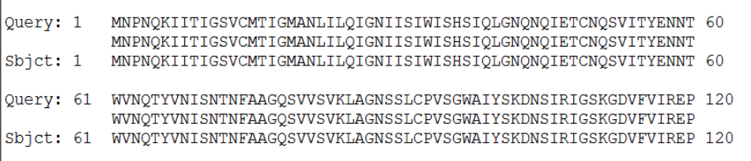
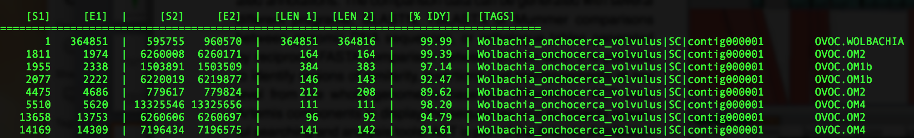
Challenge: single gene to whole genome
The output of these resources & tools is not easy to visualise / conceptualise, esp for large datasets / whole genomes
BLAST
nucmer

Slide 8
Artemis Comparison Tool (ACT)
Interactive tools to visualise and compare two or more sequences and their annotations
Useful for whole genomes down to single genes
Based on, and builds upon, Artemis
Many of the functions learnt in Artemis are the same

Slide 9
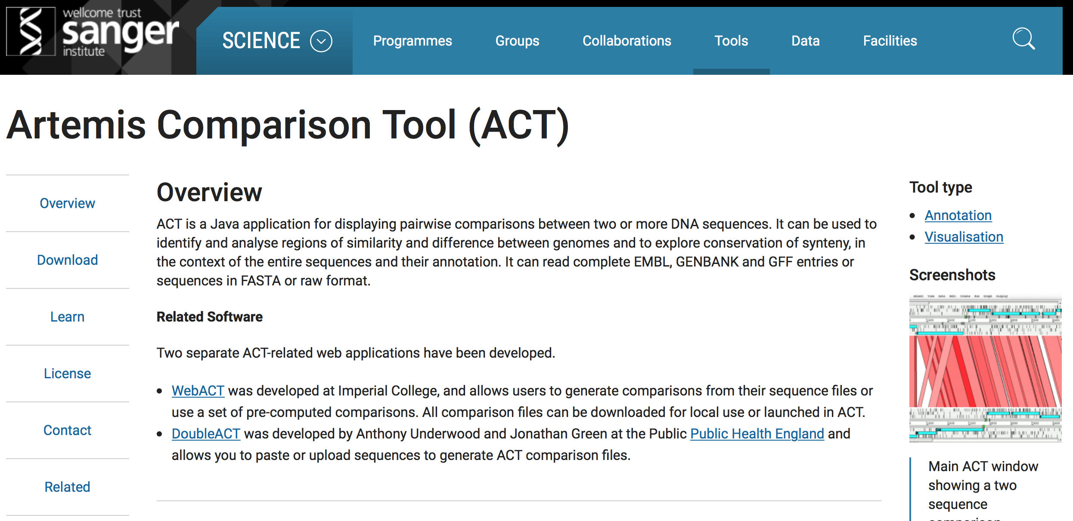
Where to find ACT?
Freely available (unix, mac, win)
- WEB: http://www.sanger.ac.uk/science/tools/artemis-comparison-tool-act
MANUAL: ftp://ftp.sanger.ac.uk/pub/resources/software/act/act.pdf
PAPER: Carver et al. (2005) Bioinformatics. 21;16;3422-3

Slide 10
What do you need to run ACT?
The program
Local install (currently on your VM desktop) or on the web (as described in your manual)
Two or more files containing sequence information
Format: Fasta, EMBL, Genbank
Output from a comparative analysis of those sequence files
Format: BLAST, mummer, VCF
Optional: Additional metadata
Format: GFF, EMBL

Slide 11
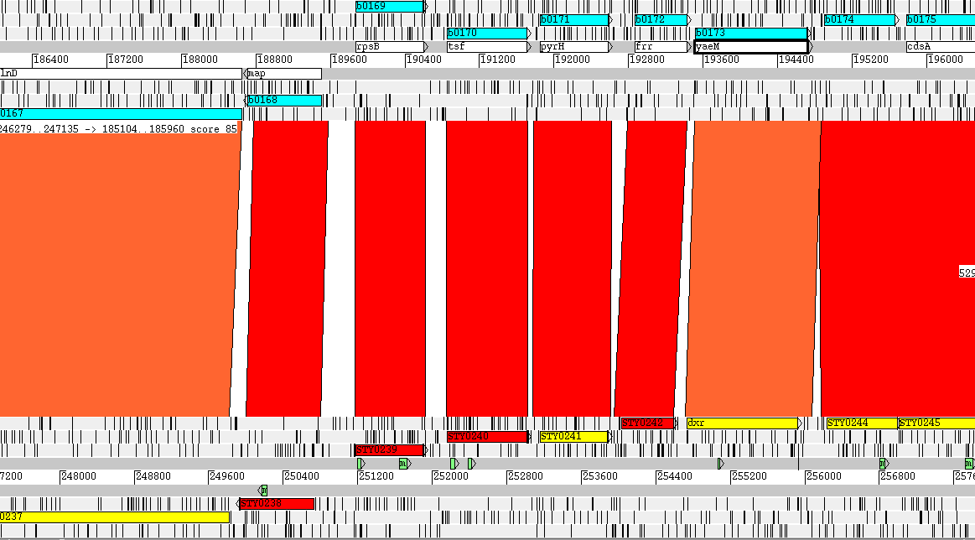
Basic setup of an ACT session
Stop codons
Sequence 1
bp
Sequence 2
6 Reading Frames
Coding sequences
Regions of homology

Slide 12
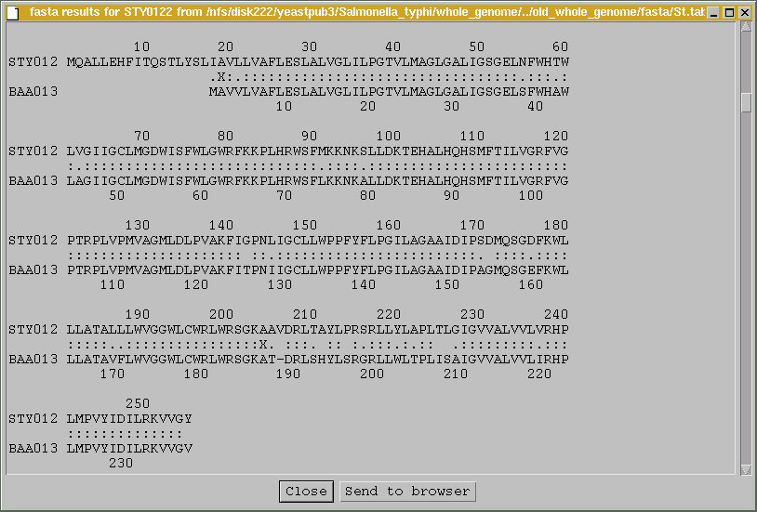
Visualising sequence similarity
MQALL…
…RHP
Region sharing similarity
(BLASTP)
MAVV…
…RHP

Slide 13
Visualising genome rearrangements
Genome 1
Blast output
Region of homology in:
Same orientation
Reverse orientation
Genome 2
Same genes present in the same orientation

Slide 14
Visualising genome rearrangements
Genome 1
Blast output
Region of homology in:
Same orientation
Reverse orientation
Genome 2
The same genes are present but the blue genes have undergone a rearrangement

Slide 15
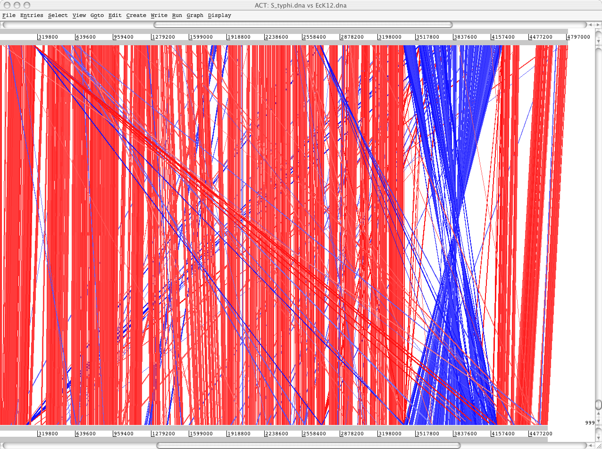
Visualising genome rearrangements
S. typhi
BLASTN
DNA-DNA
matches
E. coli

Slide 16
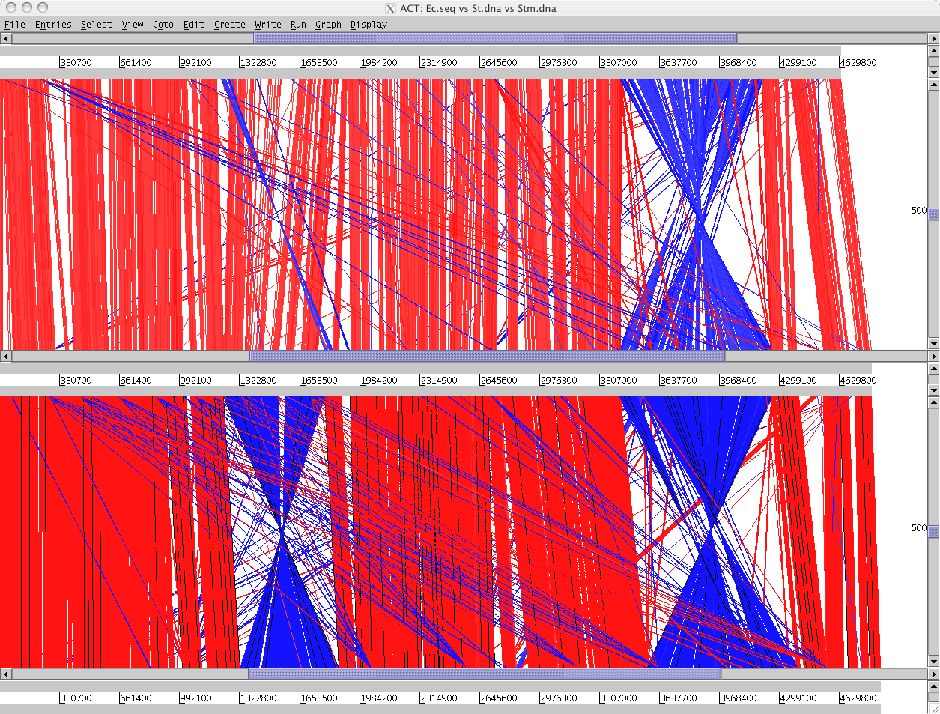
Visualising genome rearrangements
E. coli
S. typhi
S. typhimurium

Slide 17
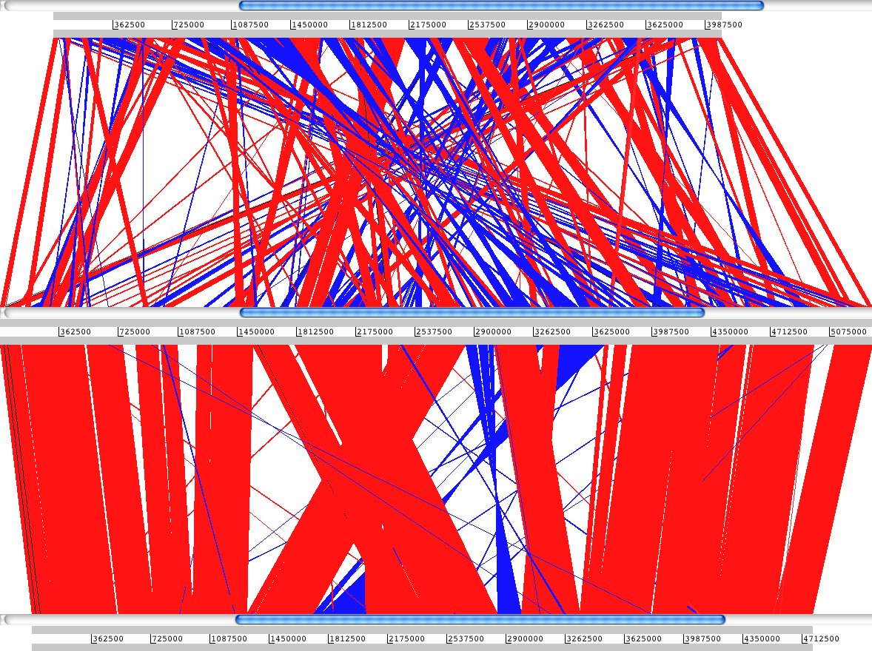
Visualising genome rearrangements: Bordetella spp.
Bordetella pertussis
B. bronchiseptica
B. parapertussis

Slide 18
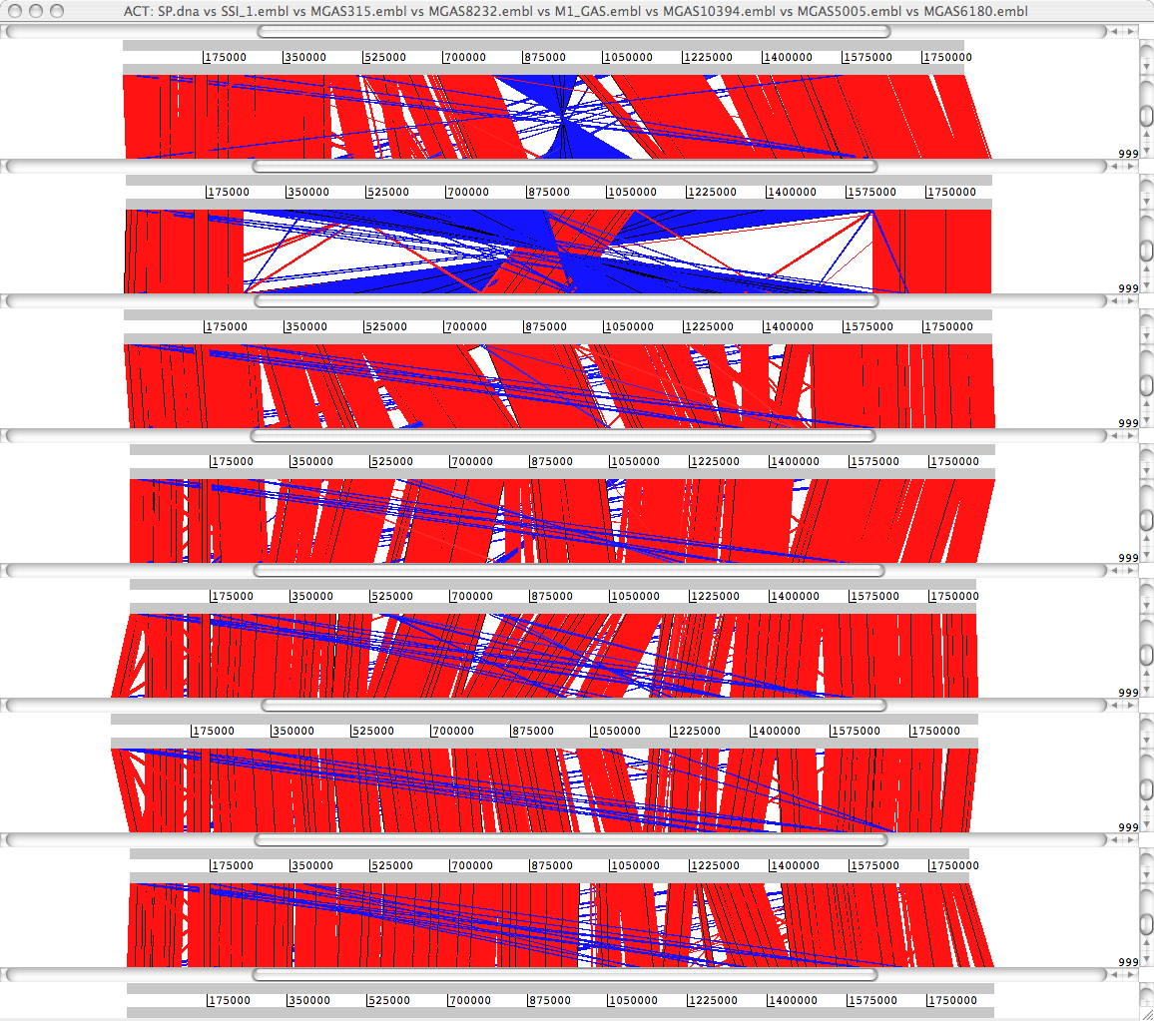
Comparison of strain diversity: Streptococcus pyogenes
Manfredo
SS_1
MGAS315
MGAS8232
M_1
MGAS10394
MGAS5005
MGAS6180

Slide 19
Comparison of genic diversity
Gene gain and/or loss
Duplication, horizontal gene transfer, indels
Gene function modification
Loss of function (pseudogenes, gene fission)
Gain of function (gene fusion)
Mutation accumulation (SNPs)

Slide 20
Visualising gene gain or loss
Genome 1
Genome 2
Example of an insertion or deletion

Slide 21
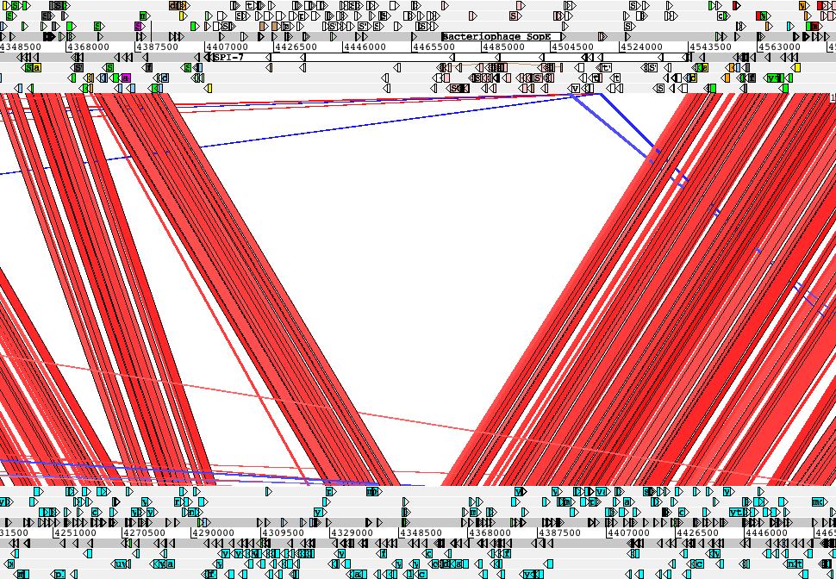
Visualising gene gain or loss
tRNA-Phe
type IV pilus
sopE
Vi antigen
S. typhi
E. coli

Slide 22
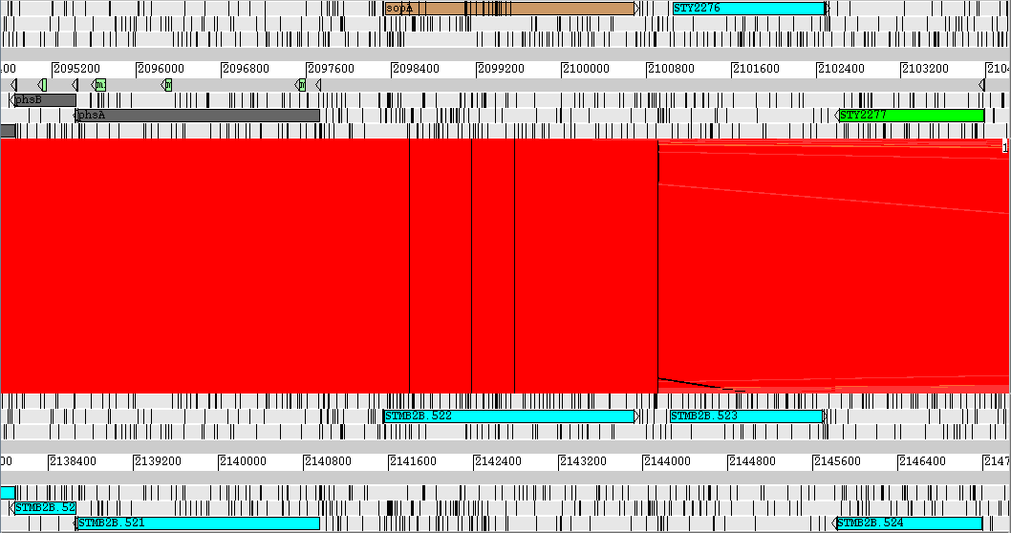
Loss of function: pseudogenes
secreted effector protein (type-III)

Slide 23
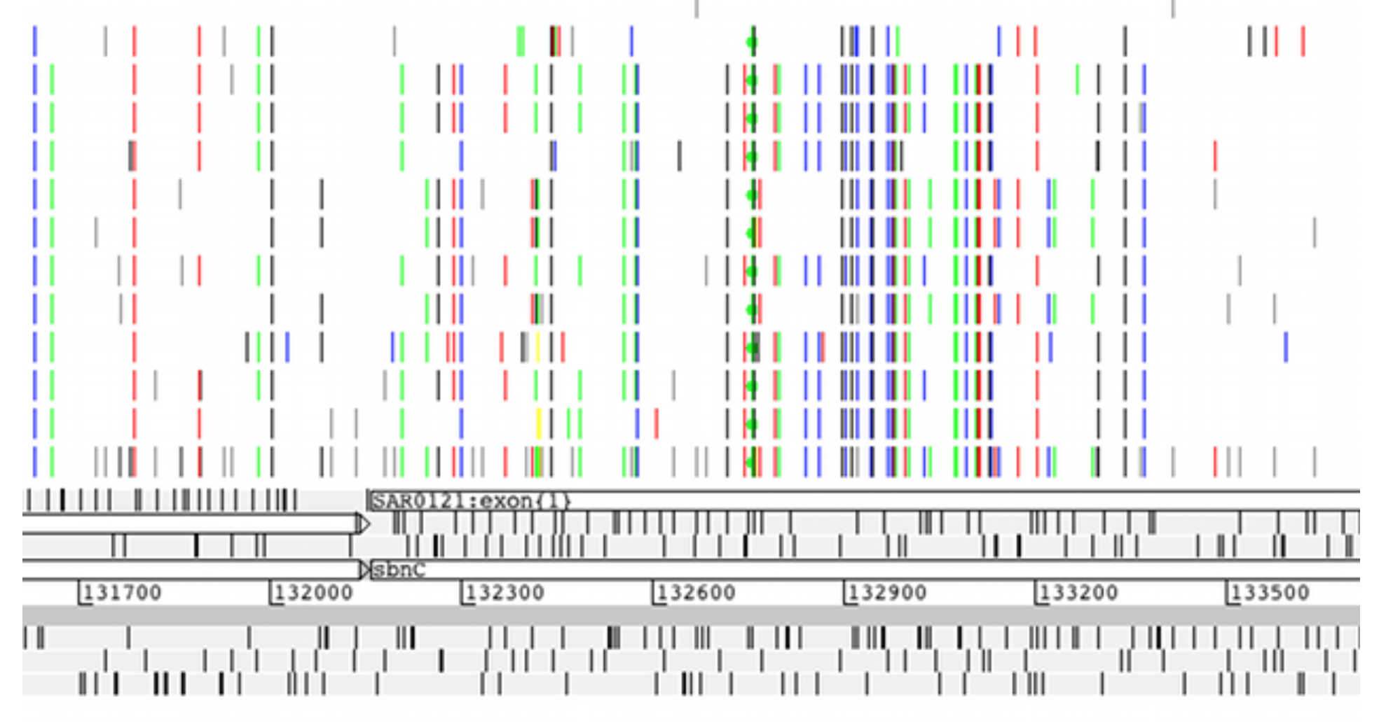
Genetic variation among populations
VCF input: row represents an individual, line represents a SNP

Slide 24
Aims of this module
Demonstrate some of the the basic functions of ACT
Enable you to perform basic comparative analyses

Slide 25
Module 4:
De novo genome assembly

Slide 26
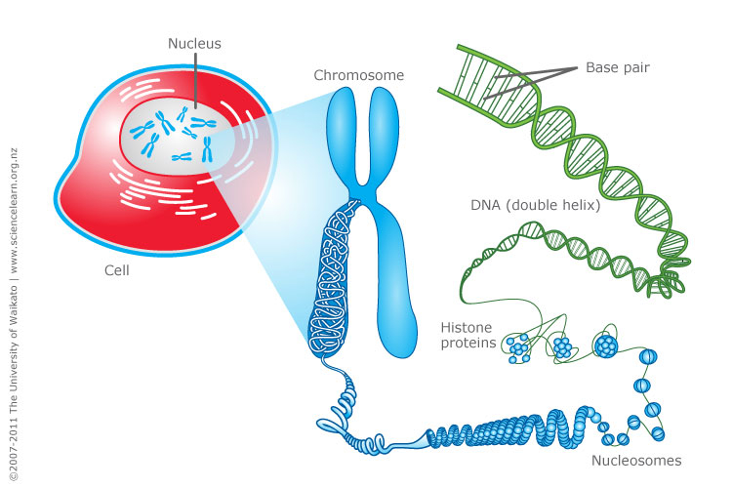
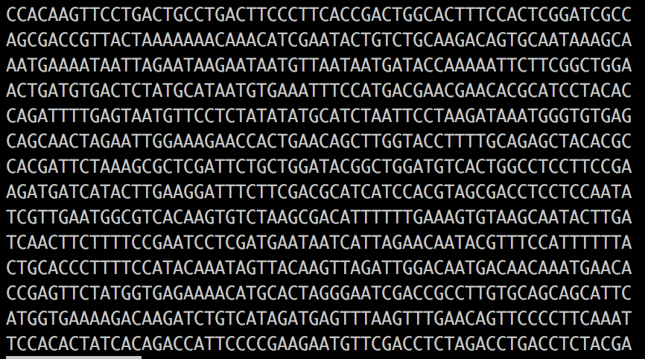

Genome sequencing is conceptually straight forward
https://www.sciencelearn.org.nz/images/198-cell-chromosomes-and-dna

Slide 27
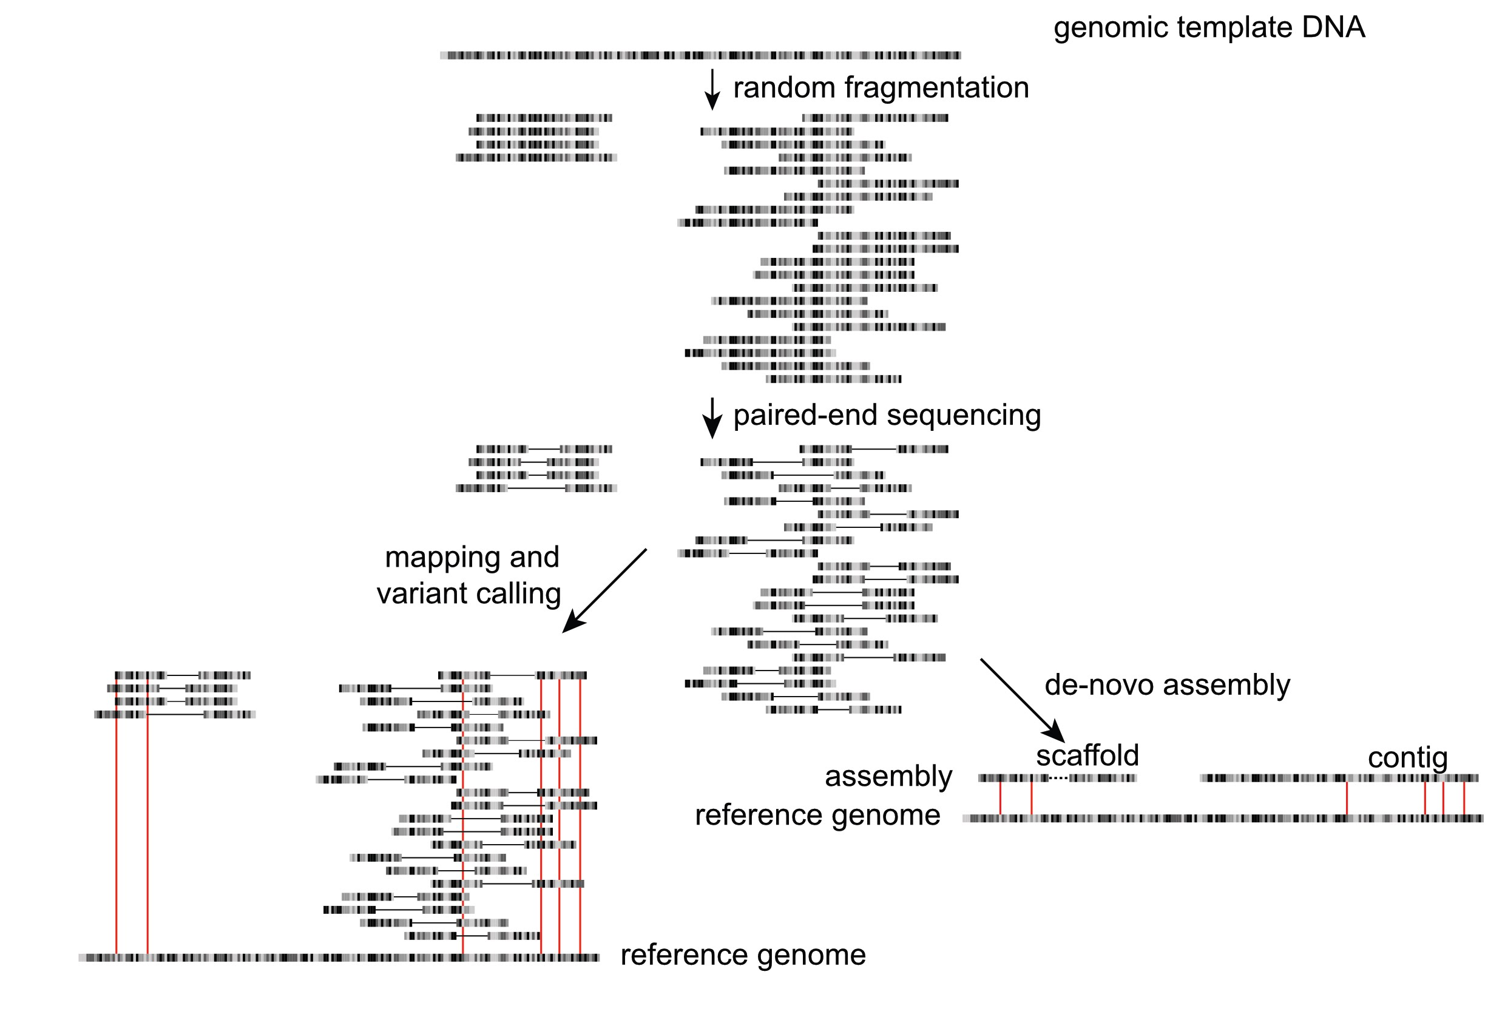
Sequencing genomes is easy…!
Sample / library preparation
Sequencing
Informatics

Slide 28
Sequencing genomes is easy, constructing good genomes is not
Genome: biologically
“the haploid set of chromosomes in a gamete or microorganism, or in each cell of a multicellular organism”
“the complete set of genes or genetic material present in a cell or organism”
Adapted from Torsten Seemann presentation: “De novo genome assembly”
https://www.slideshare.net/torstenseemann/de-novo-genome-assembly-tseemann-imb-winter-school-2016-brisbane-au-4-july-2016

Slide 29
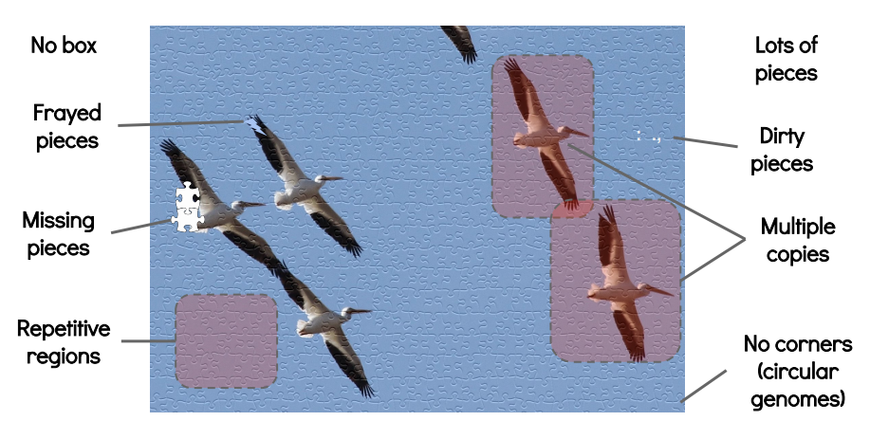
Sequencing genomes is easy, constructing good genomes is not
Genome: bioinformatically
Best guess, but often:
highly fragmented
misassembled to some degree
Haplotypic
contaminated
duplicated or missing
Chromosome-scale
genomes
HARD
Draft genomes
“manageable”(?)
Time, money, expertise
Adapted from Torsten Seemann presentation: “De novo genome assembly”
https://www.slideshare.net/torstenseemann/de-novo-genome-assembly-tseemann-imb-winter-school-2016-brisbane-au-4-july-2016

Slide 30
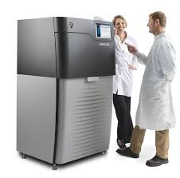
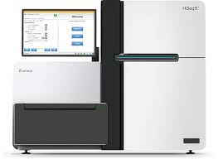
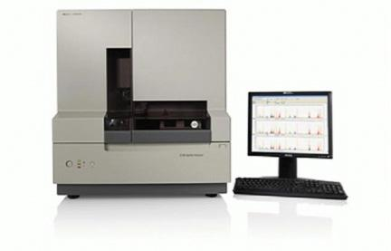
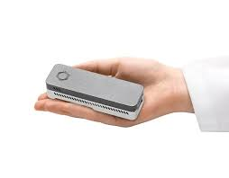
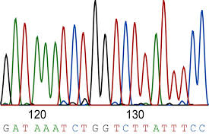
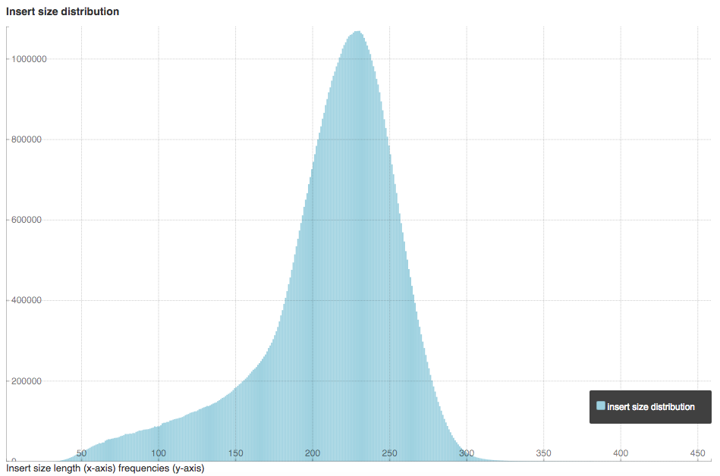
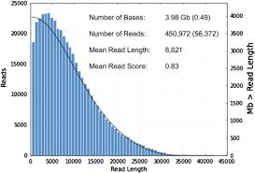
New technologies are making genome assembly easier
Sanger Sequecing: ABi
High Throughput Sequencing: Illumina
Long read sequencing: Pacbio & Nanopore
Read length:500-1000 bp
Read lengths: 100-300 bp
Insert lengths: ave 300-500 bp
Read lengths: 5-10 kb
- Pacbio: up to 60 kb
- Nanopore: up to 1Mb

Slide 31
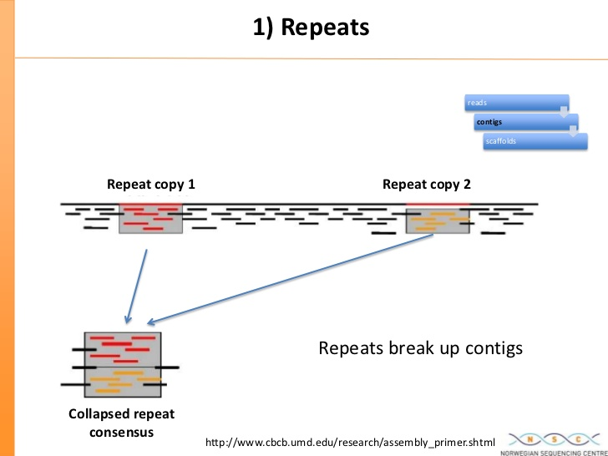
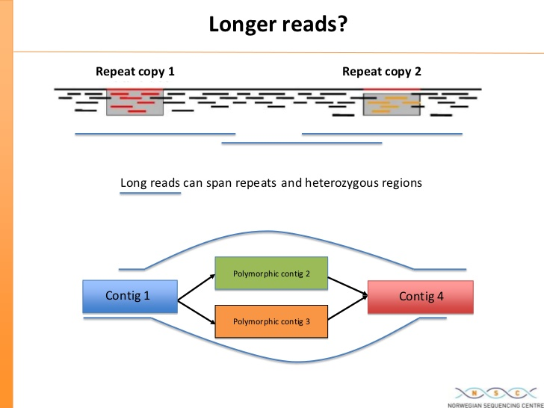
Repeats / polymorphic loci can break genomes
https://www.slideshare.net/flxlex/combining-pacbio-with-short-read-technology-for-improved-de-novo-genome-assembly

Slide 32
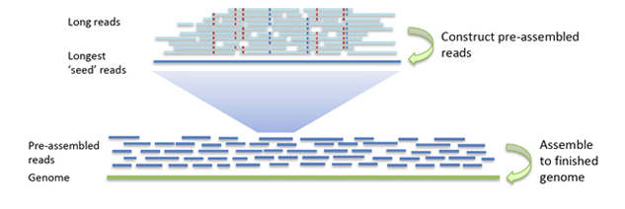
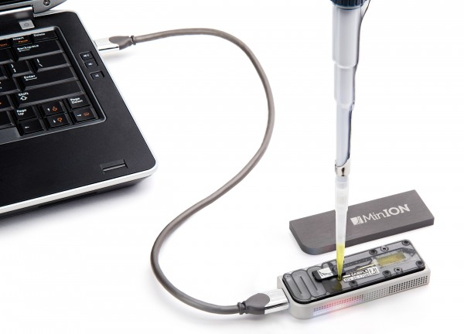
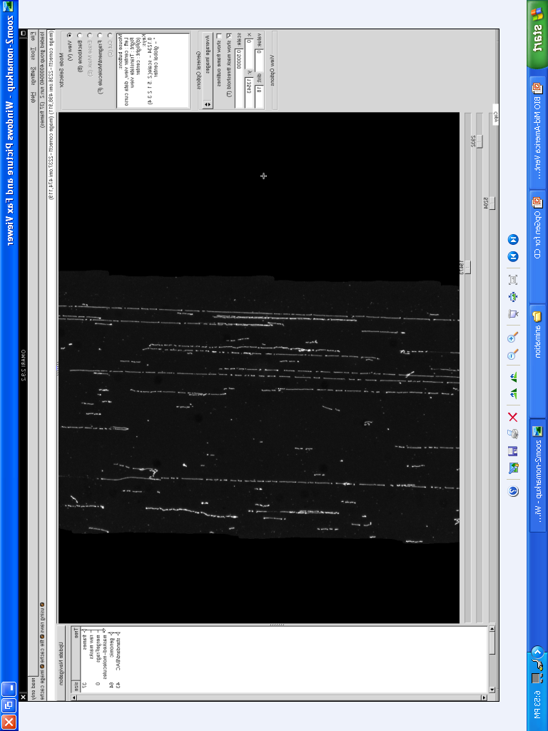
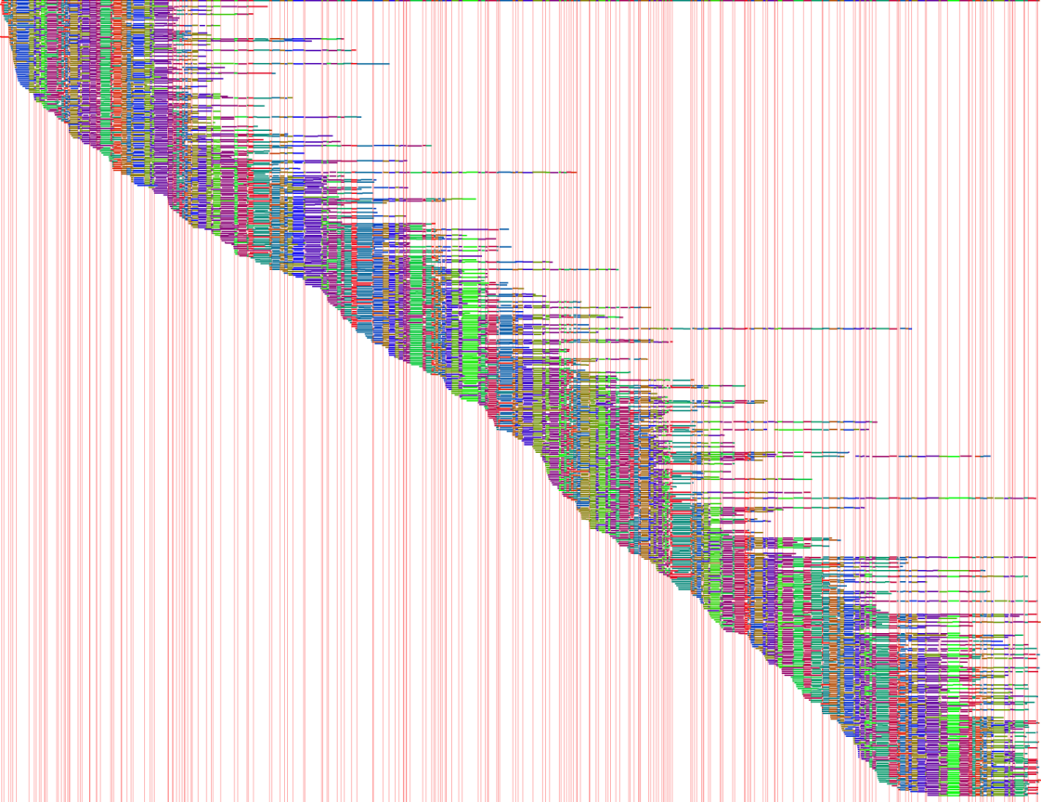
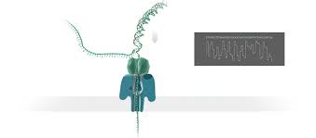
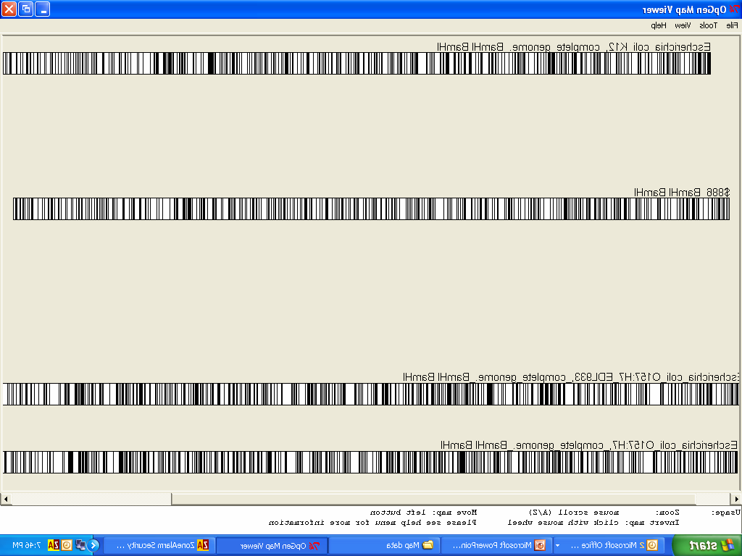
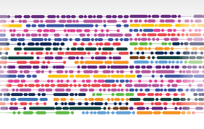
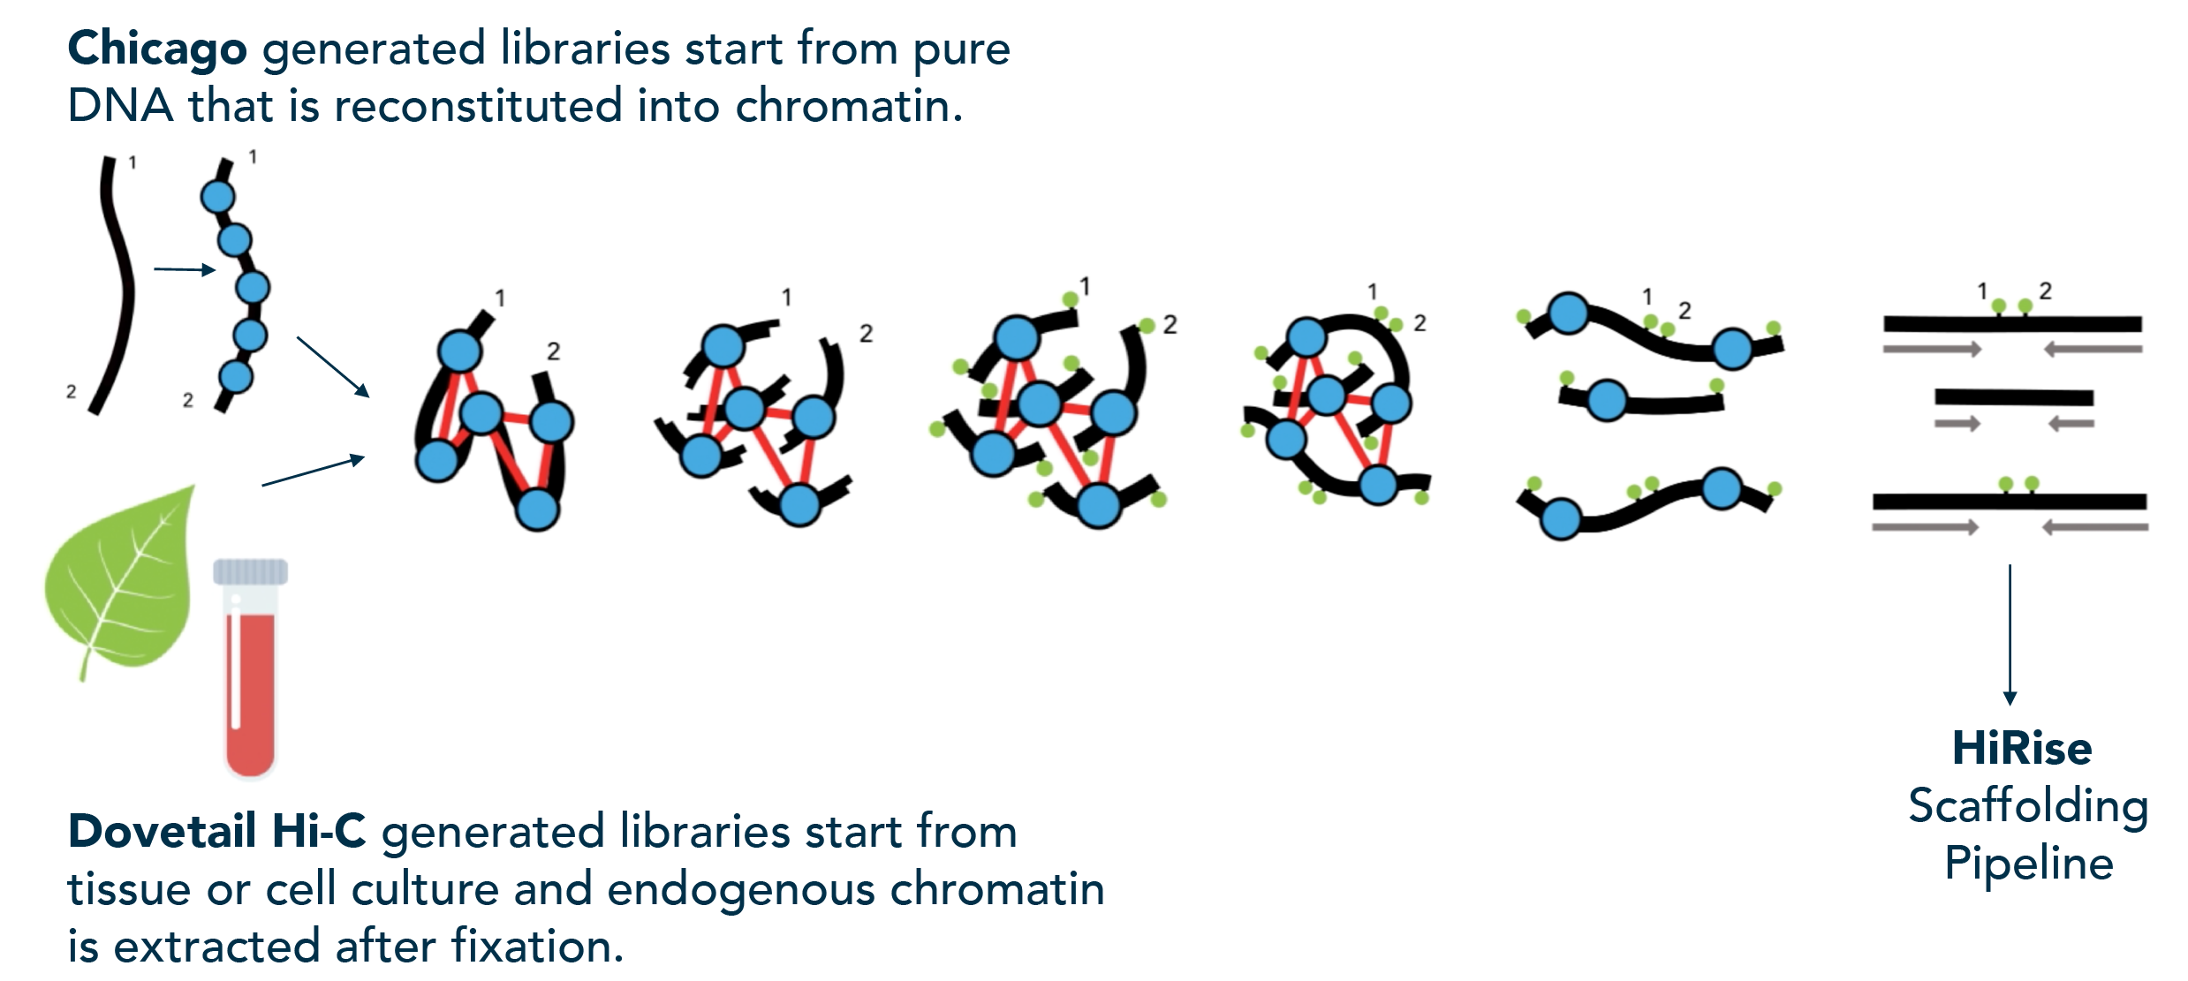
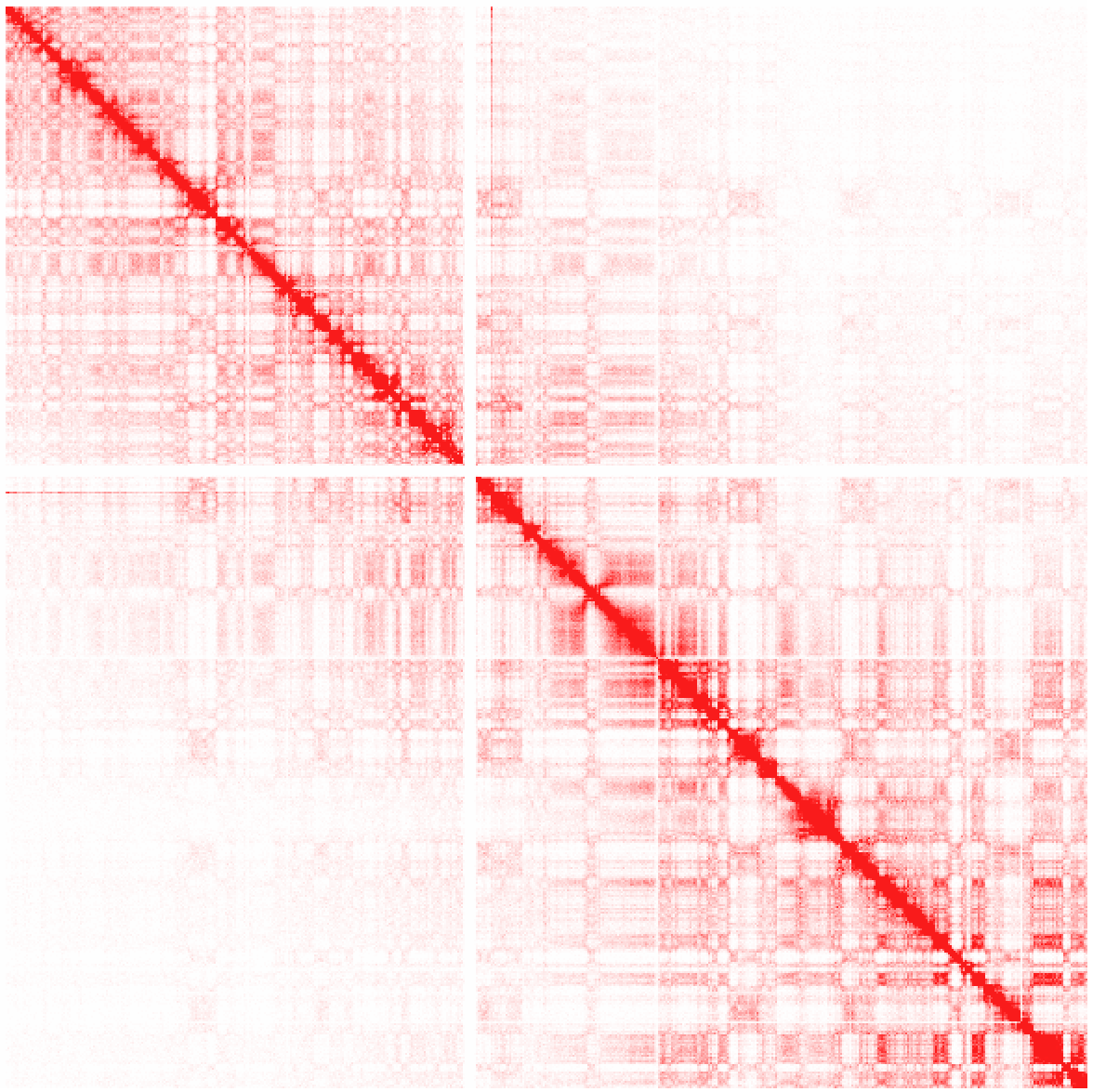
Long read / range sequencing is key to good genomes
Pacific Biosciences (PacBio)
Oxford Nanopore
Optical Mapping (OpGen, Bionano genomics)
Linked reads (10X Genomics)
consensus map
Chromosome confirmation capture, ie Hi-C (Dovetail Genomics)

Slide 33
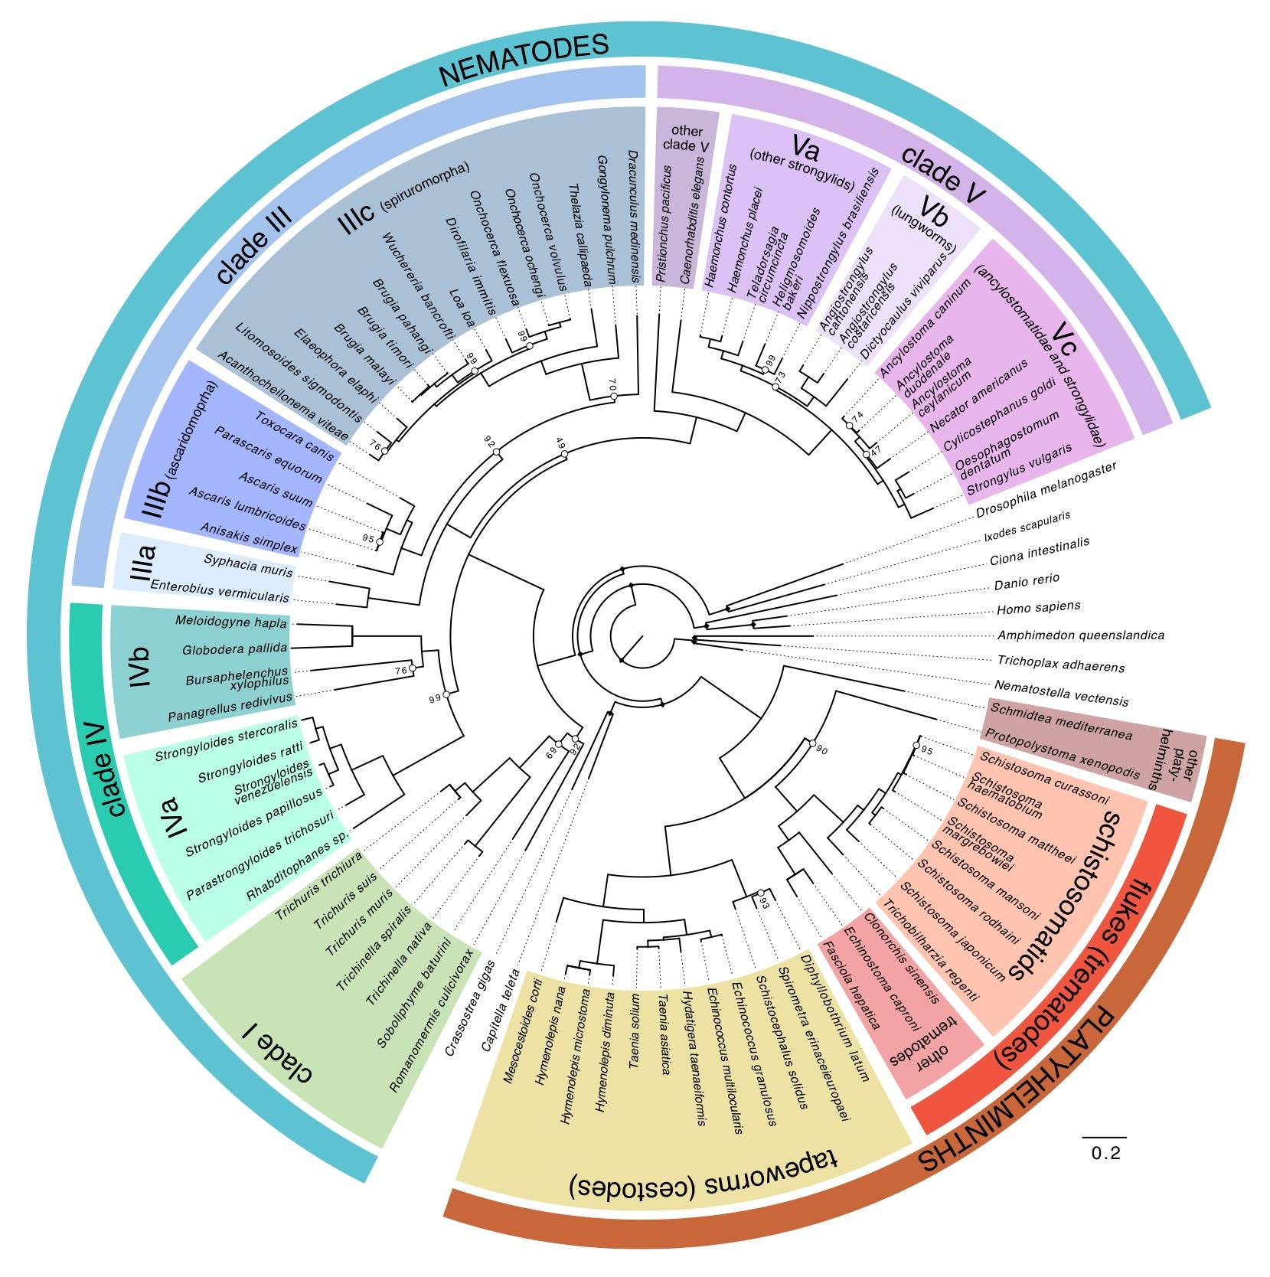
Parasite Genomics @ Sanger: 50 Helminth Genome Project
Aims:
generate draft genome assemblies for (a) clinically and veterinary important organisms and (b) parasitic groups lacking exemplars in current genome projects and (c) comparators to ‘reference’ species
(Try to) ensure similar sequencing, assembly and annotation approaches for each genome so they are truly comparable

Slide 34
Not all helminths, nor their assemblies, are created equal
N50 (bp)
N50 (n)
N50: measure of contiguity. The minimum sequence length for which 50% of the genome is in sequences at least this length

Slide 35
Chromosomal scale helminth assemblies
 | Samples / biology | Sequencing | Stage | Genome size (Mb) | Fragments | N50 (Mb) | N50(n)
Onchocerca volvulus | Single worm | SR, optical map | final | 97 | 715 | 25.5 | 2
Trichuris muris | Pooled worms, inbred lab strain | SR, Pacbio, optical map | PB only | 123 | 3708 | 0.140 | 193
 |  |  | final | 112 | 803 | 28.9 | 2
Trichuris trichura | Single worm (SR), 3 males (pacbio) | SR, Pacbio | PB only | 97 | 1344 | 0.257 | 98
 |  |  | final | 80 | 113 | 11.3 | 2
Hymenolepis microstoma | Inbred, clonal | Pacbio, optical map | PB only | 161 | 288 | 4.6 | 10
 |  |  | final | 164 | 27 | 21 | 3
Schistosoma mansoni | Clonal (Pacbio), single worms (SR) | SR, Pacbio, genetic map | PB only | 409 | 1598 | 1.05 | 97
 |  |  | final | 409 | 320 | 50.4 | 3
Haemonchus contortus | Pooled (PB), single worm (SR), semi-inbred, haplotypic | SR, PacBio, optical map | PB only | 487 | 5284 | 0.184 | 563
 |  |  | final | 279 | 8 | 47 | 3

Slide 36
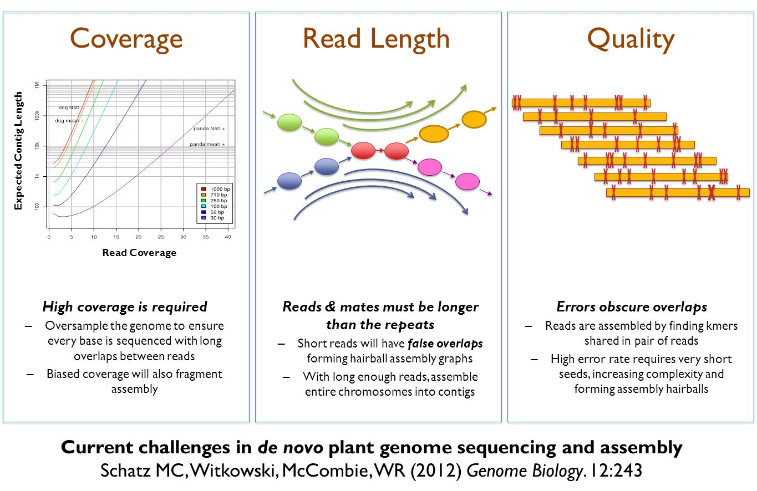
Recipe for a good genome assembly

Slide 37
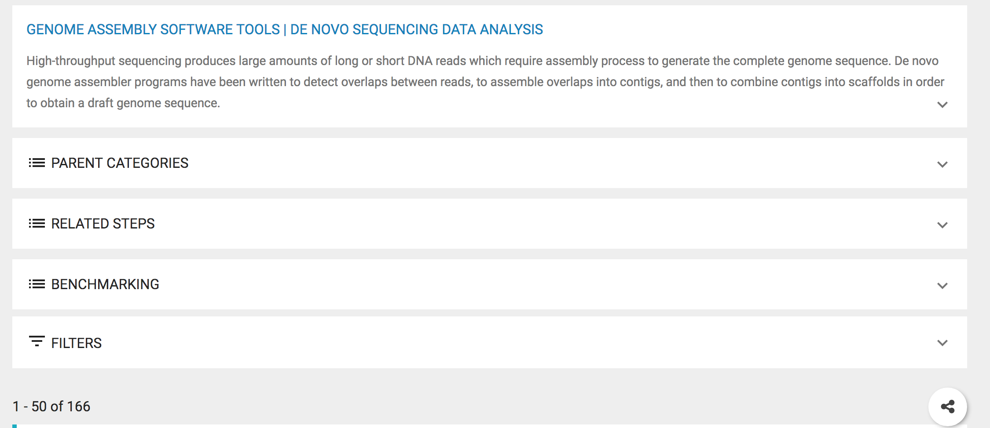
What tool(s) should I use?
https://omictools.com/genome-assembly-category

Slide 38
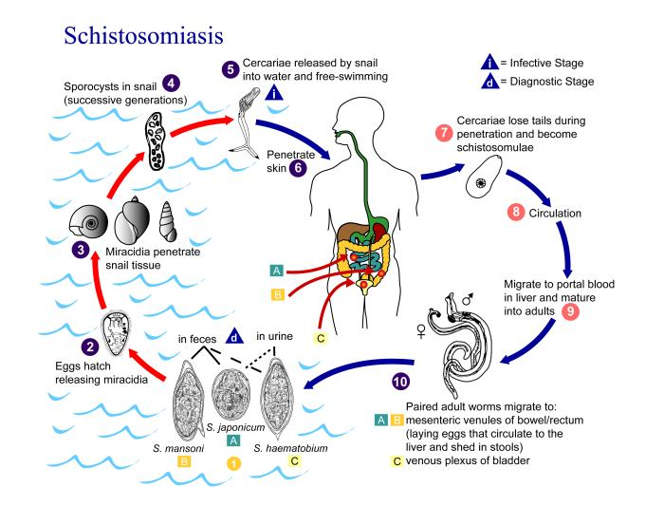
Today: Assembly of a Schistosoma mansoni chromosome
Genome
7 autosomes + Z/W sex chromosomes
approximately 380 Mb
We will work with chromosome IV
~40 Mb

Slide 39
Aims and workflow
Step 1: Checking raw sequencing data before assembly
Step 2: Estimating your genome size from raw sequence data
Step 3: Exploring different genome assembly using either Illumina short read or Pacbio long read data
Step 4: Comparison of your assemblies against a known reference sequence
Step 5: Further exploration of your genome assemblies

Slide 40
NOTE: Genome assembly is memory intensive!!!
Page 12: Unfortunately, the computers were are working on are unlikely to finish the minimap assembly.
You can skip this step, and move on to using assembly-stats to compare the pre-prepared assemblies.

